Slide 1
Git & GitHub

Slide 2
what is git?
Git is a Distributed Version Control System (DVCS), developed by Linus Torvalds in 2005. It tracks changes, allows collaboration, works offline, and stores full history.
You can go back to previous versions, see who changed what, and work with others without overwriting each other's changes.
It runs locally on your machine (you don’t need the internet to use basic Git features).
What are the uses of Git?
Maintain version history
Work on features without affecting main code
Collaborate with teams
Revert to previous versions
Merge contributions

Slide 3
git concepts
Repository (Repo): Project folder tracked by Git
Commit: Snapshot of code changes
Branch: Independent line of development
Merge: Combine branches
Clone: Copy of a remote repository.
Pull: Fetch and merge changes from remote.
Push: Upload local commits to remote.

Slide 4
repository(repo)
A Git repository is basically a folder (project) that Git is tracking.
It contains:
Your project files (like .java, .html, .txt, etc.)
A special hidden folder called .git, where Git stores all the history and changes made to your files.
Types of Git Repositories:
Local Repository:
This lives on your computer.
You use it with commands like git add, git commit, etc.
Remote Repository:
This lives on a server, like GitHub, GitLab, or Bitbucket.
You push your code to it using git push and pull changes with git pull.

Slide 5
Workflow Example:
You create a folder → MyProject.
You run git init → Now it's a Git repository.
You make some changes to Main.java.
You run git add Main.java → Git stages the file.
You run git commit -m "Add main logic" → Git saves a snapshot.
You push it to GitHub with git push → It's now backed up online.

Slide 6
what is a commit in git?
A commit in Git is like taking a snapshot of your project at a certain point in time. It saves the current state of your files so you can:
Track changes.
Revert to previous versions.
Collaborate with others without loosing work.
Technical Definition: A commit records the staged changes (files you've added using git add) into the repository history, along with:
A commit message (description of the change).
A unique ID (SHA hash).
The author’s name and email
A timestamp

Slide 7
How It Works
git add file.txt # Stage the file
git commit -m "Add file.txt with initial content" # Commit it
After this, Git:
It stores the file’s version.
It saves the commit info in history.
And moves HEAD (the current pointer) to the new commit

Slide 8
What is a Branch in Git?
A branch in Git is like a parallel version of your codebase. It lets you work on new features, fixes, or experiments without affecting the main (usually stable) code.
A copy of your project where you can make changes freely, and later merge them back.
Why Branches Are Useful:
Isolate features or bug fixes.
Avoid conflicts with others.
Test ideas safely.
Collaborate efficiently on large projects.

Slide 9
Git Branch Structure:
The default branch is usually called main or master.
You can create new branches like:
feature/login-page
bugfix/signup-error
experiment/theme-redesign
Common Branch Commands:
git branch # List all branches
git branch new-feature # Create a new branch
git checkout new-feature # Switch to that branch
git checkout -b test-ui # Create & switch in one step

Slide 10
Merging Branches:
Once your work on a branch is done, you can merge it into another branch:
git checkout main
git merge new-feature
This brings all changes from new-feature into main.
Most commonly:
You finish working on a branch (like feature-xyz) and want to bring those changes into main → You merge it.

Slide 11
What is Merge in Git?
Merging in Git is the process of combining changes from one branch into another.
Simple Use Case:
You have two branches.
main (your production code).
feature-login (where you're adding a login feature).
Once you're done with the feature:
git checkout main # Go to the branch you want to update
git merge feature-login # Bring in the changes from feature-login
Now your main branch has all the code from feature-login.

Slide 12
What Actually Happens:
Git:
Finds the common ancestor of both branches.
Applies the changes made on the feature branch.
Creates a new merge commit that joins them together.
Before Merge:
main: A---B
\
feature: C---D
After Merge:
main: A---B-------E
\ /
C---D
E is the merge commit that combines all the work.

Slide 13
What if there are conflicts?
Sometimes, Git can’t automatically decide which change to keep. This causes a merge conflict.
You’ll see:
CONFLICT (content): Merge conflict in file.txt
To resolve:
Open the file
Choose which version to keep
Save, then run.

Slide 14
What is clone in Git?
In Git, git clone is a command used to create a full copy of an existing Git repository (including its entire history) from a remote location to your local machine.
Command Syntax: git clone <repository-url>
This will:
Download all files.
Set up a local Git repo.
Create a folder named my-project.
Link it to the remote GitHub repository.

Slide 15
What Happens Internally:
Copies all branches, commits, and tags.
Sets the remote as origin (default remote name).
You're now ready to run git pull, git push, git commit, etc..
After Cloning, You Can:
Switch branches (git checkout branch-name).
Make changes & commit.
Push updates (git push).
Pull new changes (git pull).

Slide 16
What is git pull in Git?
git pull is a command that fetches the latest changes from a remote repository and merges them into your local branch.
It’s like syncing your code with the latest version from GitHub (or any remote repo).
Syntax: git pull <remote> <branch>
What it actually does:
git pull is a shortcut for two commands:
git fetch # Download changes from remote
git merge # Merge them into your current branch

Slide 17
What is git push in Git?
git push is the command you use to upload your local commits to a remote repository, like GitHub.
Syntax: git push <remote> <branch>
Where does it push to?
origin = the default name for the remote repo (usually GitHub).
main = the branch you are pushing (could also be dev, feature-xyz, etc.).

Slide 18
Git Workflow
Working Directory → git add → Staging Area → git commit → Local Repo → git push → Remote Repo.Remote
Repo <--- git pull --- Local Repo
↓
Working Directory
↓
git add (Stage)
↓
git commit (Save snapshot)
↓
git push ---> Remote Repo

Slide 19
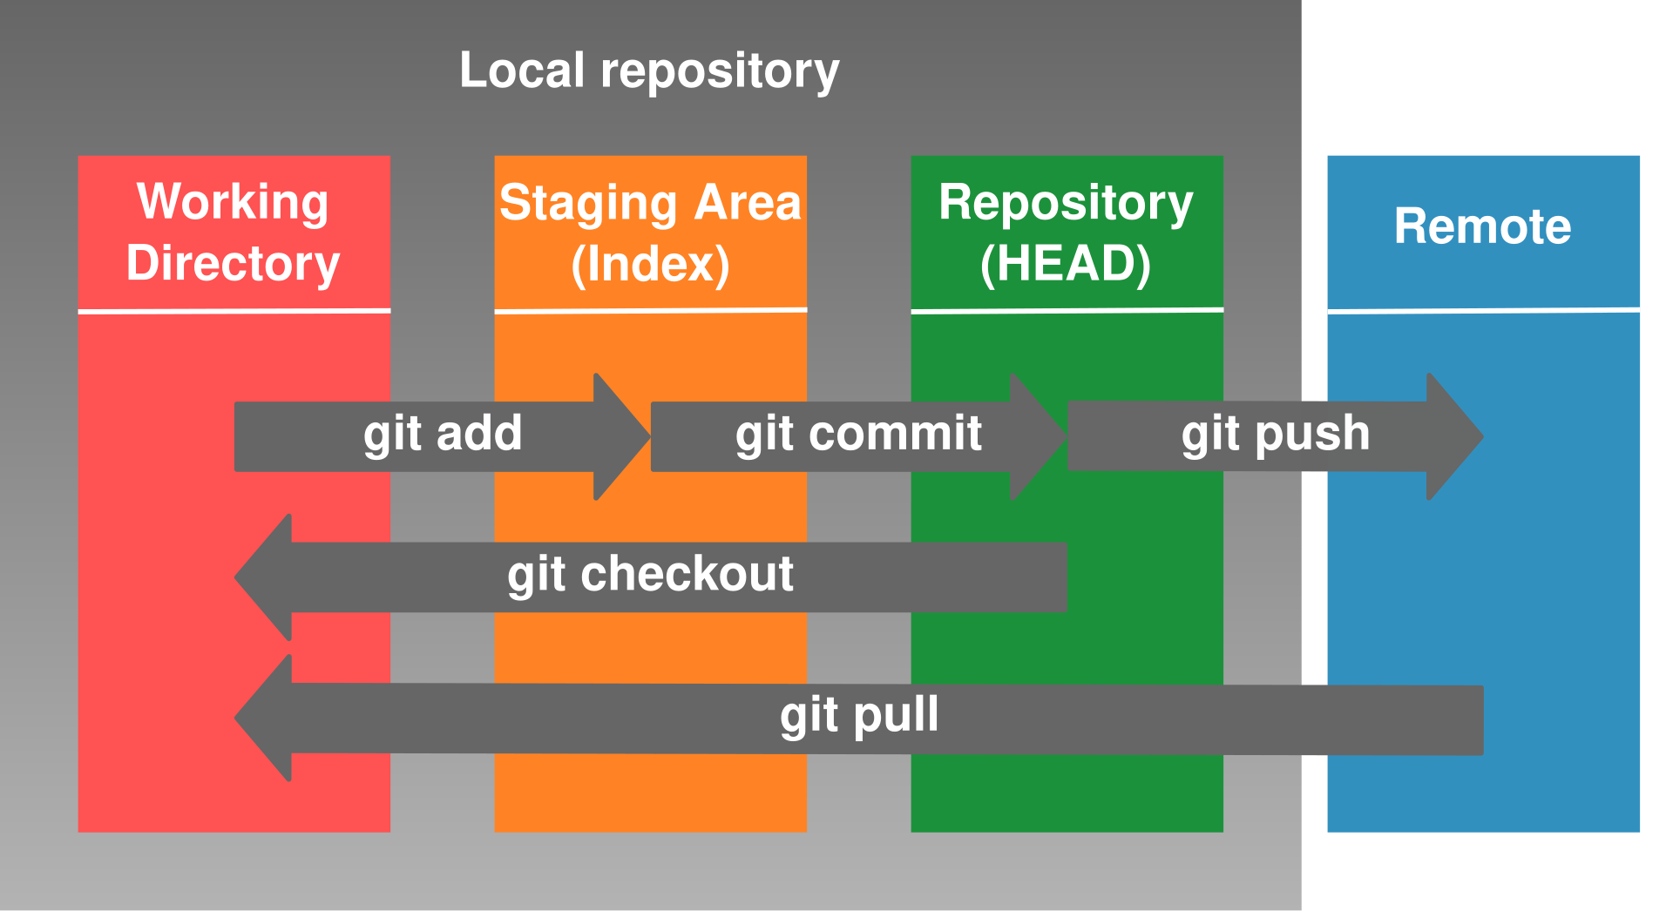

Slide 20
Clone the Repository (if working with remote)
Get a copy of the repo from GitHub:
git clone <repo-url>
Create or Switch to a Branch
Start working in a new branch to avoid touching the main code:
git checkout -b feature-login
Make Changes to Your Code
Edit your files in your code editor.
Stage Your Changes
Add the files you want to commit:
git add file1 file2
# or add all
git add .

Slide 21
Commit the Changes
Save a snapshot of your staged changes:
git commit -m "Add login feature"
Pull the Latest Changes (If Working With Others)
Before pushing, sync with the remote to avoid conflicts:
git pull origin main
Resolve Merge Conflicts (if any)
Git will alert you if changes clash. Fix them manually and commit again.
Push Your Changes
Send your local commits to the remote repo:
git push origin feature-login

Slide 22
Open a Pull Request (on GitHub)
If you're using GitHub:
Open GitHub in browser.
Compare your branch with main.
Create a Pull Request (PR).
Add reviewers (if you're on a team).
Review and Merge
Once the PR is approved:
Merge into the main branch.
Optionally delete the feature branch.

Slide 23
Team Workflow (Feature Branch Workflow):
This is very common in teams using GitHub:
main stays clean and deployable.
Everyone creates feature branches.
Work, commit, and push to those branches.
Submit Pull Requests for review.
Merge into main after approval.

Slide 24
what is github?
GitHub is a cloud-based platform that hosts Git repositories. It is a website that allows to developers to store and manage their code using Git.
We uplode our projects in GitHub in the format of folders[ those folders are called a repositories (repo) in GitHub language].
It's where you can store your code online.
You can collaborate with others easily, manage issues, pull requests, and more.
It's like social media for code — with features like profiles, followers, stars, etc.
Term | Role
Git | Tool to track changes in code.
GitHub | Website to host and share Git code.

Slide 25
Key GitHub Features
Repositories
Issues & Pull Requests
Branch protection
Code review tools
GitHub Actions (CI/CD)
Wiki & Documentation

Slide 26
What is a Repository in GitHub?
A repository (or repo) on GitHub is like a project folder that stores all the files, history, and settings related to a coding project.
It as a digital workspace where code lives, evolves, and is shared with others.
A GitHub Repository Contains:
Code files (e.g., .java, .py, .html, etc.).
Version history (every commit you've made).
Branches (different versions of your code).
README file (project overview or documentation).
GitHub Actions (for automation like testing or deployment).
Issues (to track bugs or tasks).

Slide 27
Common GitHub Repo Operations:
Action | Purpose
Clone | Download the repo to your local machine.
Fork | Copy someone else’s repo under your account.
Push | Upload local changes to GitHub.
Pull | Download new changes from GitHub.
Create PR | Propose your changes to be added to the repo.

Slide 28
Why Use Repositories?
Central place for your code.
Collaborate with teammates.
Track changes and history.
Share open source or private projects.
Automate workflows (tests, builds, deployments).

Slide 29
What are Issues in GitHub?
An Issue is like a to-do, bug report, or discussion thread in your project.
It as a place to talk about something that needs to be fixed, improved, or discussed.
Common Uses for Issues:
Reporting bugs.
Suggesting new features.
Documenting tasks.
Starting a conversation or planning.

Slide 30
What is a Pull Request(PR) in GitHub?
A Pull Request is a way to propose changes to a repository. It allows you to ask someone to review and merge your changes into another branch (usually main or dev).
Pull Request Workflow:
You create a new branch: feature/login-form.
You make changes and push it to GitHub.
You open a Pull Request to main from your branch.
Teammates can:
Review the code.
Comment or suggest changes.
Approve or request changes.
Once approved, it gets merged into the target branch.

Slide 31
Relationship Between Issues & PRs:
You can link PRs to Issues (e.g., "Fixes #12").
When merged, the issue is automatically closed.
Issues describe the problem.
Pull Requests deliver the solution.
Summary:
Feature | Purpose
Issues | Report bugs, plan features, discuss.
Pull Requests | Propose and review code changes

Slide 32
What is Branch Protection in GitHub?
Branch protection rules in GitHub let you control what actions are allowed on specific branches, especially your main or production branches like main or master.
It is used to setting up security gates for your branch to avoid accidental mistakes.
Why Use Branch Protection?
To prevent:
Direct pushes to sensitive branches.
Merging unreviewed or broken code.
Accidentally deleting important branches.

Slide 33
Common Protections You Can Enable:
Require Pull Requests Before Merging
Force developers to open a Pull Request (PR).
Ensures code is reviewed before being merged.
Require Status Checks to Pass
Run tests (CI/CD) automatically before allowing merge.
Example: Code must pass all unit tests.
Require Reviewers
At least 1 or more team members must approve the PR.
Require Signed Commits
Enforce cryptographically signed commits.

Slide 34
Restrict Who Can Push
Only certain users/teams can push to the branch.
Require Branch to Be Up-to-Date
Ensure the PR is based on the latest version of the base branch before merging.
Prevent Force Pushes & Deletion
Stop users from using git push --force.
Protect the branch from being deleted.

Slide 35
Example Workflow with Protection:
Dev creates feature/signup.
Makes changes and pushes.
Opens PR to merge into main.
GitHub runs tests automatically.
Teammates review & approve.
Only then can the code be merged.

Slide 36
Protection Type | What It Does
Require PR | Forces review process.
Require Tests | Ensures quality via CI/CD.
Require Approvals | Encourages team feedback.
Prevent Force Push/Deletion | Keeps branch history safe.
Restrict Access | Gives control over who can make changes.

Slide 37
What is a Code Review Tool in GitHub?
The code review tool in GitHub is built right into Pull Requests (PRs). It lets team members review, comment, suggest changes, and approve code before it gets merged into the main branch.
It as a formal check-up for your code before it becomes part of the real project.
Benefits of Code Review in GitHub:
Benefit | Description
Improves Code Quality | Catch bugs, improve structure & readability.
Knowledge Sharing | Helps team learn from each other’s code.
Increases Transparency | Everyone sees what’s going into the codebase
Reduces Risk | Stops bad code from reaching production.

Slide 38
Extra Features GitHub Offers for Review:
Required Reviewers: Force specific people or teams to approve before merging.
Review Summary: Shows who has approved, requested changes, or still reviewing.
Conversation Tab: Tracks the entire PR discussion.
Suggested Changes: Let reviewers suggest edits inline.
Resolve Conversations: Mark issues in the review as resolved.

Slide 39
What Can You Do in a GitHub Code Review?
View Changes Side-by-Side
See exactly what was added, changed, or removed.
Compare old vs. new code line-by-line.
Comment on Specific Lines
Highlight code and leave comments or questions.
Request Changes
Block merging until specific changes are made.
Approve the PR
Give a green light for the code to be merged.
Add Suggestions
Directly suggest edits in the code.
Can be committed with one click by the author.

Slide 40
Code Review Flow in GitHub:
Developer creates a feature branch.
Pushes changes and opens a Pull Request.
Reviewers get notified and review the code.
Reviewers can:
Comment
Approve
Request changes
Once approved and all checks pass → Merge the PR.

Slide 41
What are GitHub Actions?
GitHub Actions is a CI/CD (Continuous Integration and Continuous Deployment) tool built into GitHub.
It lets you automate workflows like:
Running tests
Building your code
Deploying your app
Sending alerts
And more — automatically when something happens in your repo

Slide 42
What Can You Automate?
Task | Example
Run tests | Before merging code.
Lint code | On every push.
Build a project | Compile/build before deploy.
Deploy to server/cloud | Auto-deploy to Heroku, AWS, etc.
Auto-generate release notes | When tagging a release.
Sync branches | Keep branches in sync.

Slide 43
How GitHub Actions Work:
You create a workflow file in .github/workflows/
The file is written in YAML format.
You define:
Trigger (when to run).
Jobs (what to do).
Steps (specific commands)

Slide 44
GitHub Workflow
Fork repo
Clone to local
Create new branch
Make changes
Push to GitHub
Create Pull Request
Review & Merge

Slide 45
Create or Clone a Repository
Create a new repo on GitHub, or
Clone an existing one to your local machine:
git clone https://github.com/username/repo-name.git
Create a Branch
Always work in a separate branch instead of the main branch:
git checkout -b feature/login-page
Make Code Changes
Edit, add, or delete files in your local working directory.
Stage the Changes
Mark files to be included in the next commit:
git add .
# or add specific files:
git add index.html style.css

Slide 46
Commit the Changes
Create a snapshot of your changes:
git commit -m "Add login page UI with basic validation"
Pull Latest Changes from Remote (if needed)
Before pushing, get the latest updates from the remote repository:
git pull origin main
Push Your Branch to GitHub
Send your local branch to GitHub:
git push origin feature/login-page
Open a Pull Request (PR)
Go to the repository.
Click Compare & Pull Request.
Choose feature/login-page → main
Add a title, description, and reviewers.

Slide 47
Code Review & Feedback
Team members:
Review your code.
Leave comments.
Suggest changes or approve.
CI/CD Actions (Optional)
GitHub Actions may:
Run tests.
Build the project.
Lint the code.

Slide 48
Merge the Pull Request
After approval and successful checks:
Click Merge.
Optionally delete the branch.
Pull Merged Code Locally
To keep your local main branch updated:
git checkout main
git pull origin main

Slide 49
Common Git Commands
git init – Initialize repo
git status – Check status
git add – Stage changes
git commit -m – Save changes
git push – Send to remote
git pull – Get changes
git branch – List branches

Slide 50
git vs github
Feature | Git | GitHub
Type | Tool(VSC) | Platform(Hosting)
Works Offline | Yes | No
Collaboration | Limited | Excellent
Developed by | Linus Torvalds | GitHub Inc(MSFT)

